Slide 1
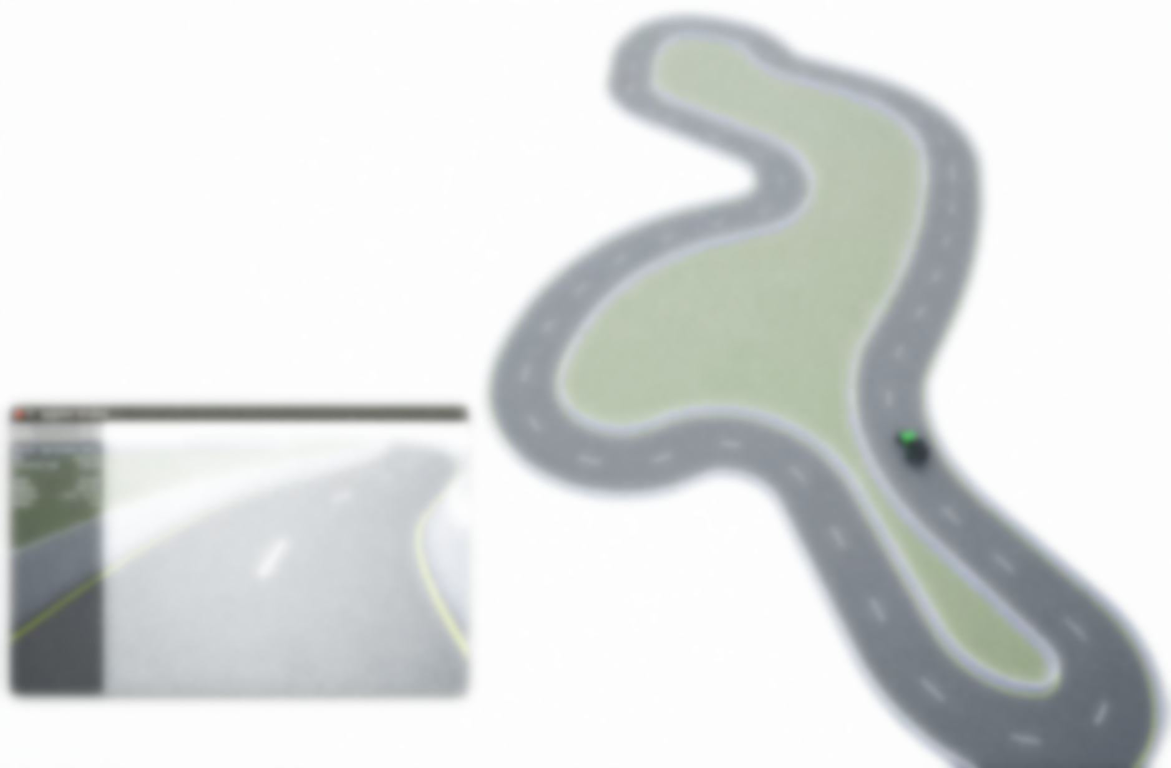
MoCAD: Carla-python Experimental Course
Carla Sensors and Control a Vehicle by Keyboard

Slide 2
Course contents
Carla RGB-camera Sensor
Time step (Frame per second FPS)
Synchronous and Asynchronous
Control a Vehicle by Keyboard
Sensors: Depth-camera, collision, GNSS …

Slide 3
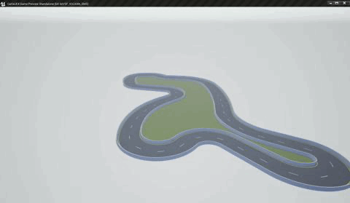
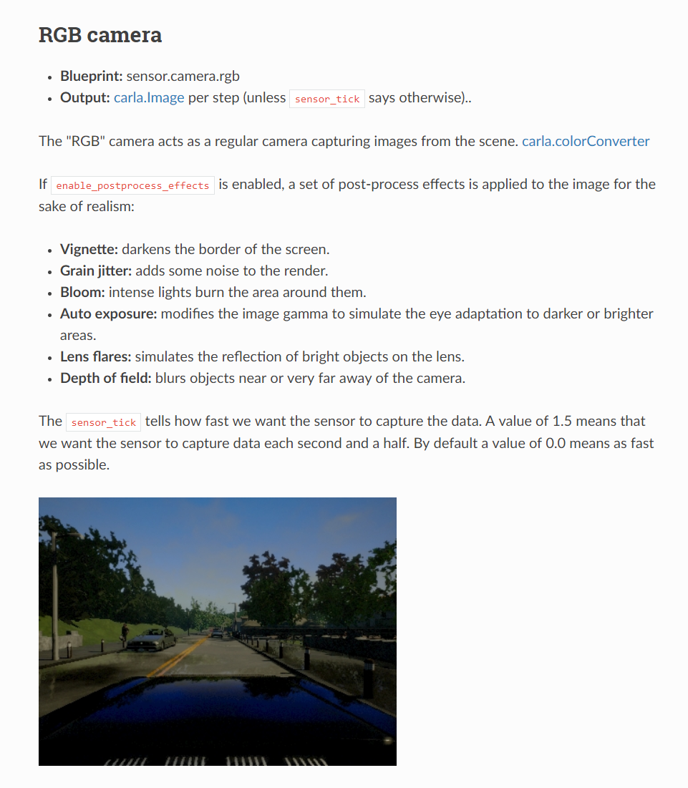
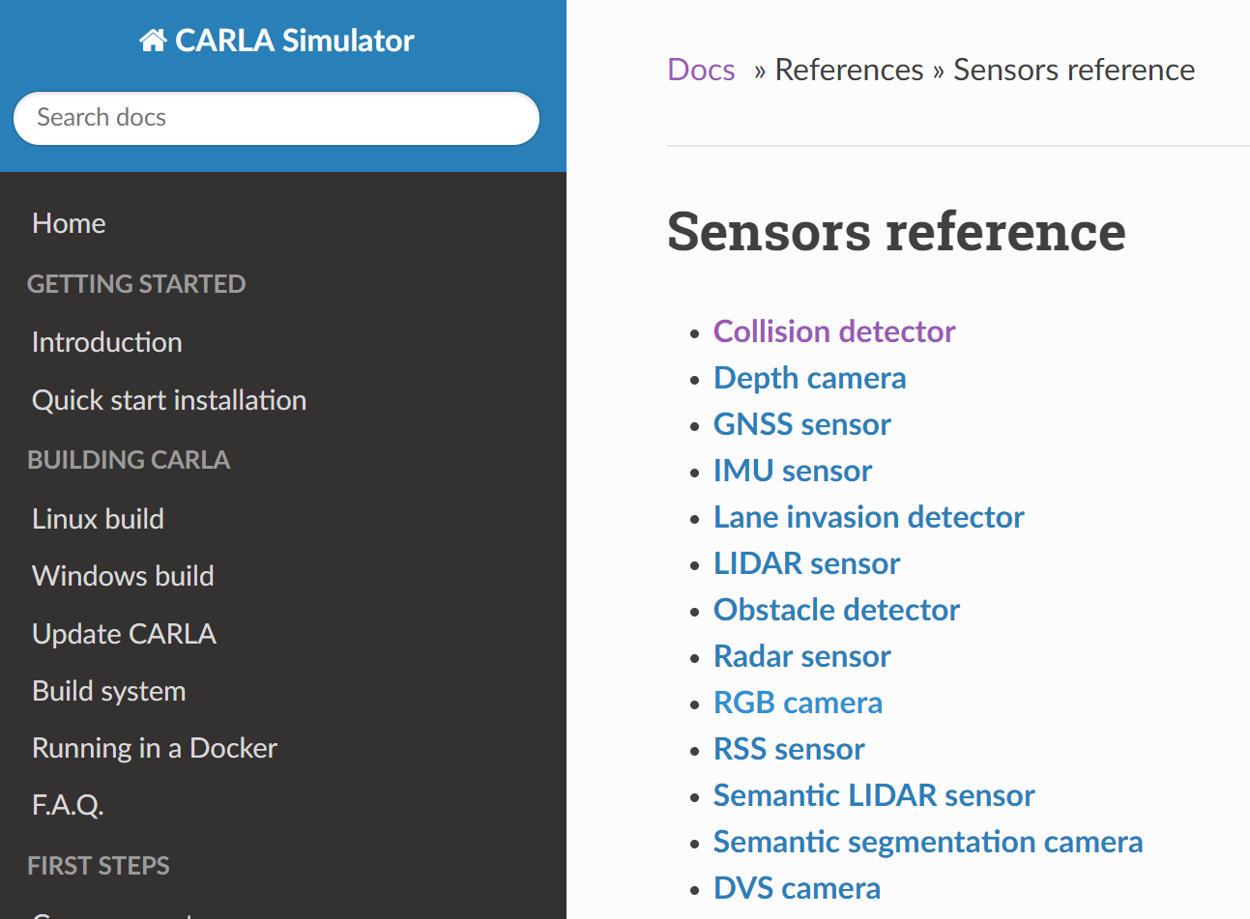
1. Carla RGB-camera Sensor
Use Carla Doc for sensors
Notes:
如何使用官方手册学习sensors

Slide 4
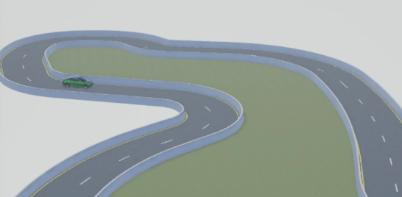
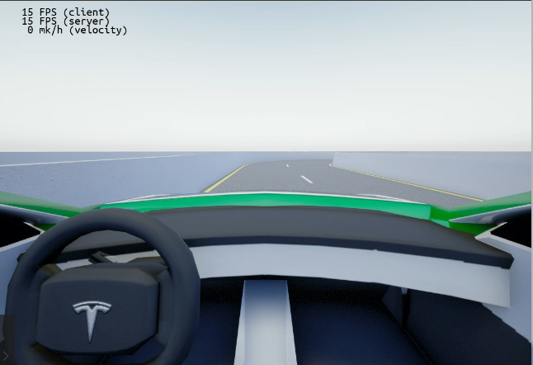
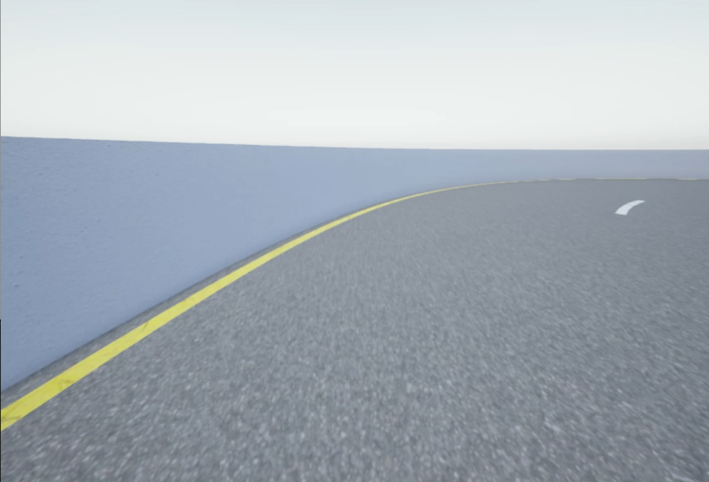
1. Carla RGB-camera Sensor
Create RGB-camera sensor
rgb_camera_bp = blueprint_library.find('sensor.camera.rgb')
RGB-camera blueprint；
Set the attribute of camera;
Add camera sensor to the vehicle;
Server listen to the data;
Add to actor list to destroy;
rgb_camera_bp.set_attribute("image_size_x", %f"%(IMG_WIDTH)) rgb_camera_bp.set_attribute("image_size_y", "%f"%(IMG_HEIGHT)) # image height rgb_camera_bp.set_attribute("fov", "110") # Horizontal field of view in degrees
spawn_point = carla.Transform(carla.Location(x=2.5, y=0.0, z=1.0), carla.Rotation(pitch=-20.0, yaw=0.0, roll=0.0)) sensor = world.spawn_actor(rgb_camera_bp, spawn_point, attach_to=vehicle)
sensor.listen(lambda data: process_img(data))
Notes:
Create rgb-camera sensor

Slide 5
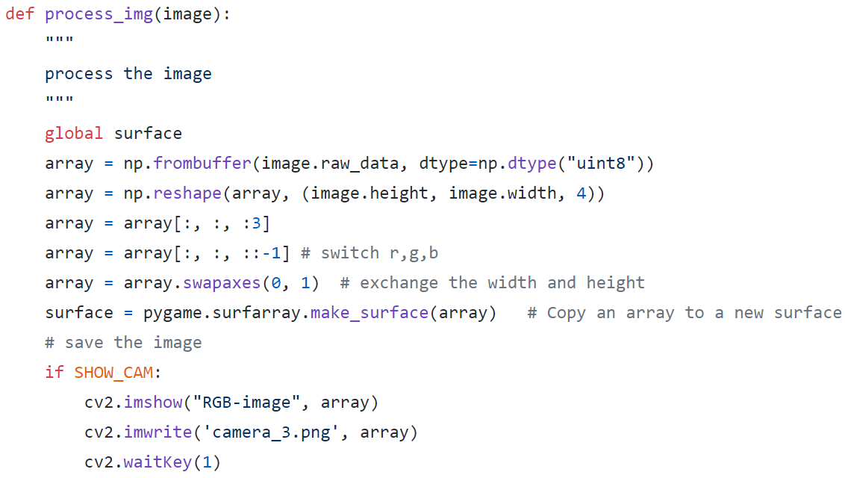
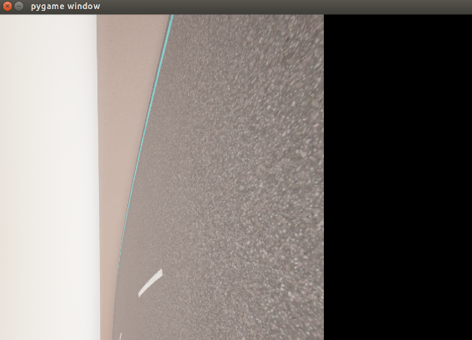
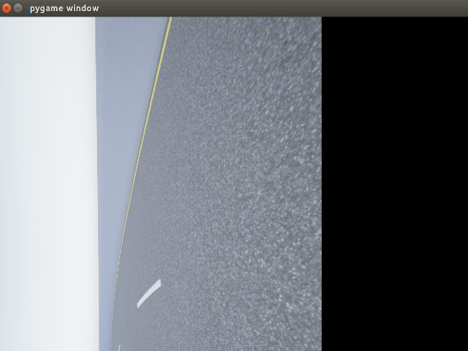
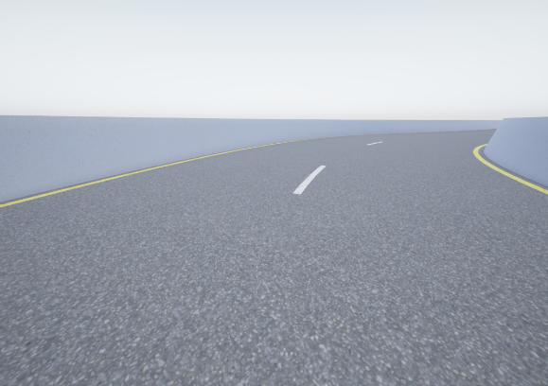
1. Carla RGB-camera Sensor
RGB-camera sensor: listen to data
Raw image;
RGB channels;
Switch width and height;
Pygame shows the image;
Carla.SensorData->Carla.Image;
Problems：
RGB-image Frame per second （FPS）？；
Server Carla simulator FPS ? ;
Server – Client Synchronous or Asynchronous ？
Process the image
Notes:
针对于主要问题讲解fps，把sensor data数据结构放到后面；

Slide 6
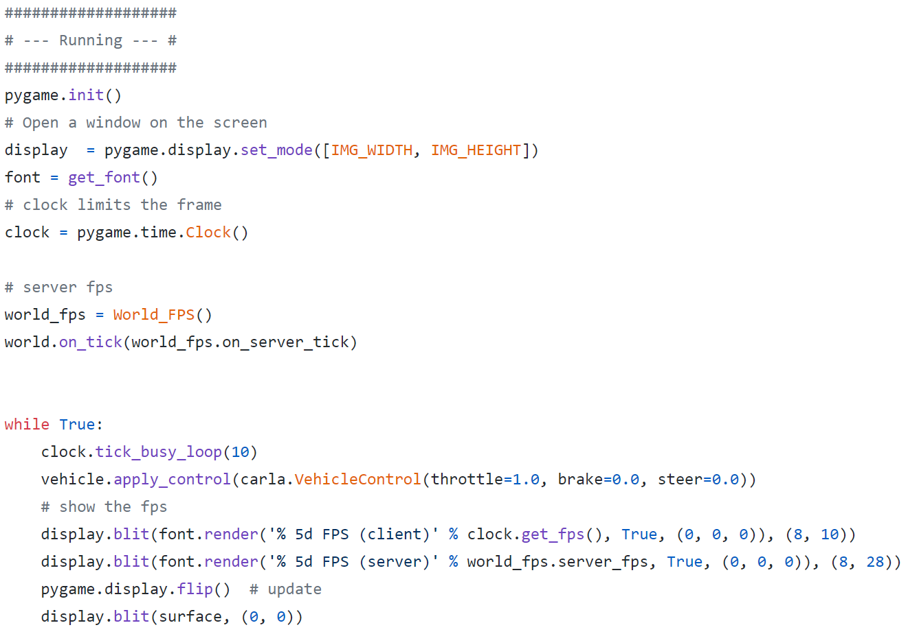
2. Time step (Frame per second FPS)
Client -- pygame
1. Apply pygame clock
2. Tick 10 fps
3. Highest FPS is up to your PC
4. Time step

Slide 7
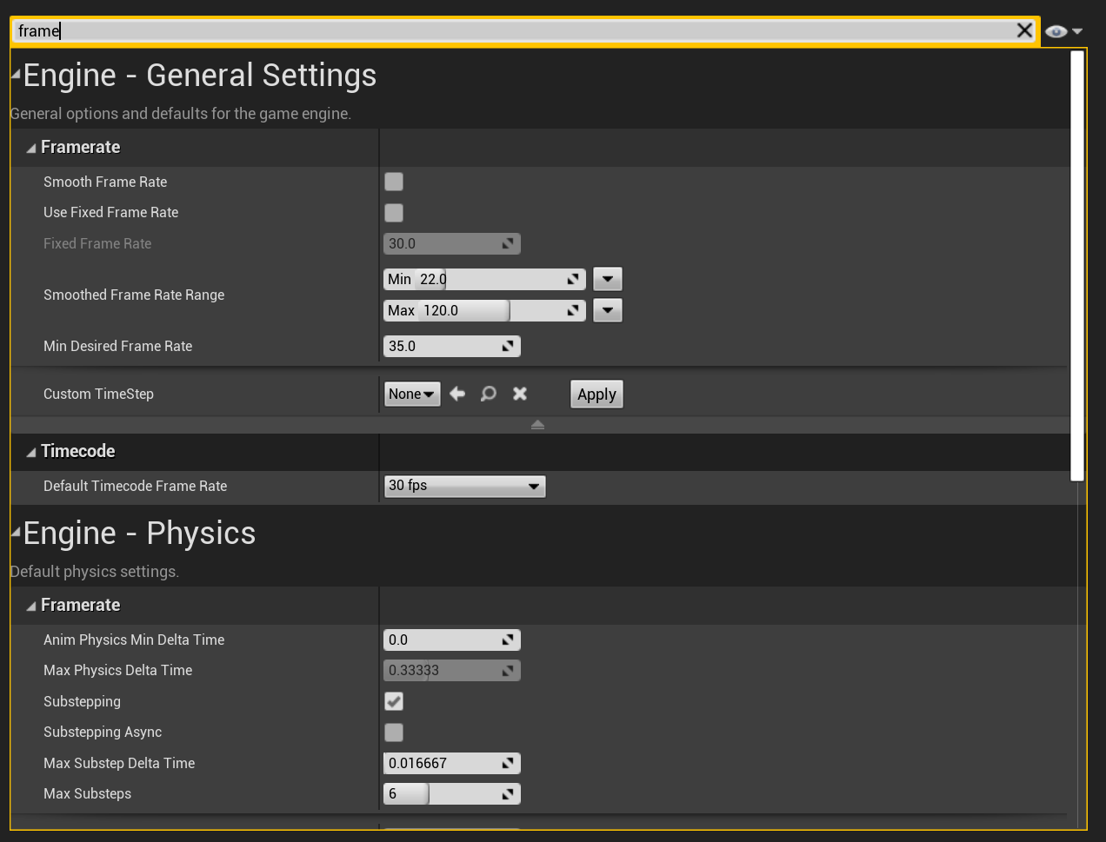
2. Time step (Frame per second FPS)
Server: Carla simulator
Simulation time-step
The time span that went by between those two simulation moments；
Real time （client）and simulation time （server）；
Time-step can be fixed or variable depending on user preferences；
Limitation：If the time-step is greater than 0.1,
there will not be enough physical substeps.
2. Why simulation time-step
Collect data；
Simulation recording；
Time-step can be fixed or variable in UE4
3. Server – Client (synchronous or asynchronous)
Sensor data: The simulator waits for the sensor data to be ready before sending the measurements.
Control message: The simulator halts each frame until a control message is received.
Notes:
Doc 中重点讲解的内容：https://carla.readthedocs.io/en/latest/adv_synchrony_timestep/

Slide 8
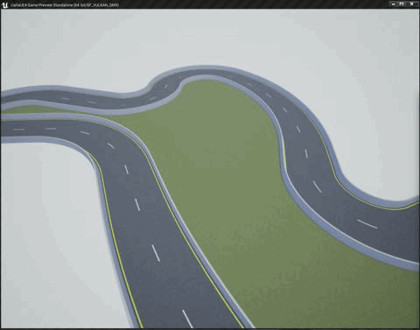
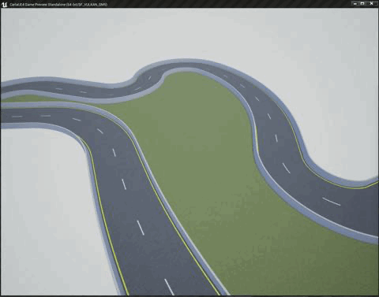
3. Synchronous and Asynchronous
Server: Carla simulator
Server(fps:15)/Client(fps:10)
Server(fps:15)/Client(fps:1)
Synchronous(fps:15)
By default, CARLA runs in asynchronous mode：The server runs the simulation as fast as possible, without waiting for the client.
Synchronous mode：the server waits for a client tick, a “ready to go” message, before updating to the following simulation step.
If the client is too slow and the server does not wait, there will be an overflow of information. many sensors and asynchrony, it would be impossible to know if all the sensors are using data from the same moment in the simulation.
Notes:
异步的可能产生的效果，
Carla默认的模式是异步的

Slide 9
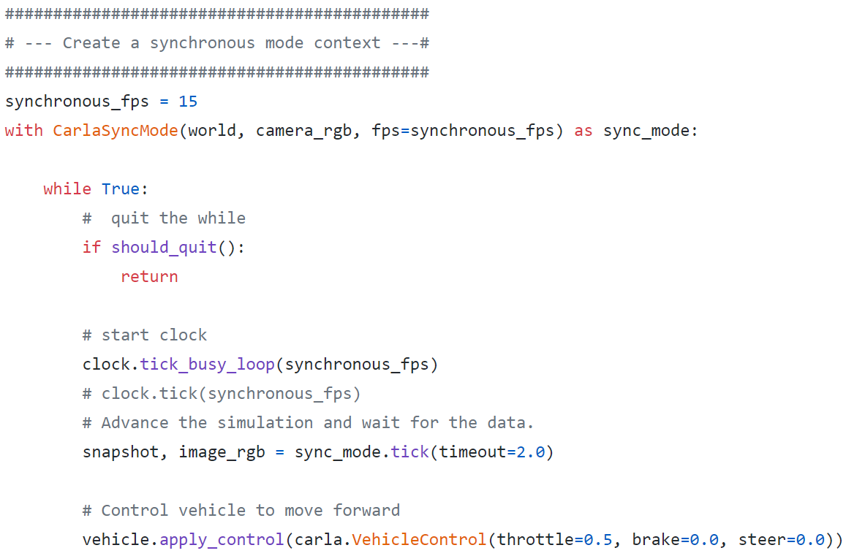
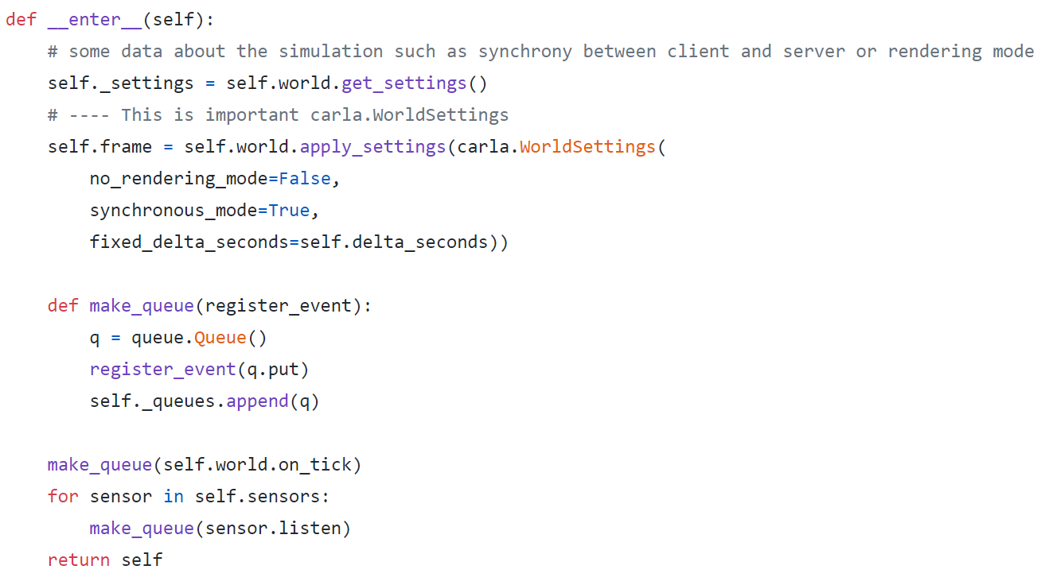
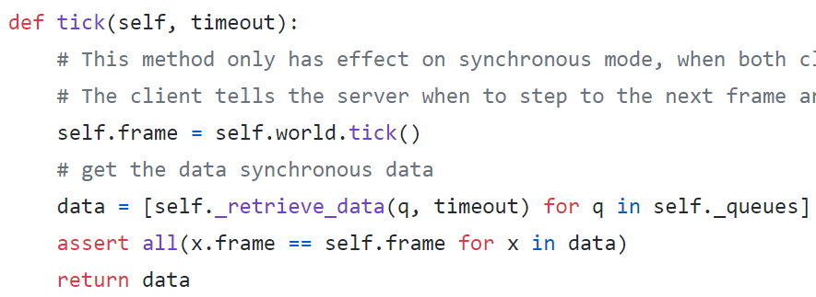
3. Synchronous and Asynchronous
Using synchronous mode
1. Carla SyncMode class
1.1 SyncMode
1.2 Queue
2. Client FPS
3. Sensor data
2.1 timestamp
Notes:
同步的实现，主要难点在于server 时钟和client 时钟使用。
保持传感器数据同timestamp
Synchronous什么时候无法同步呢？
carla.WorldSettings

Slide 10
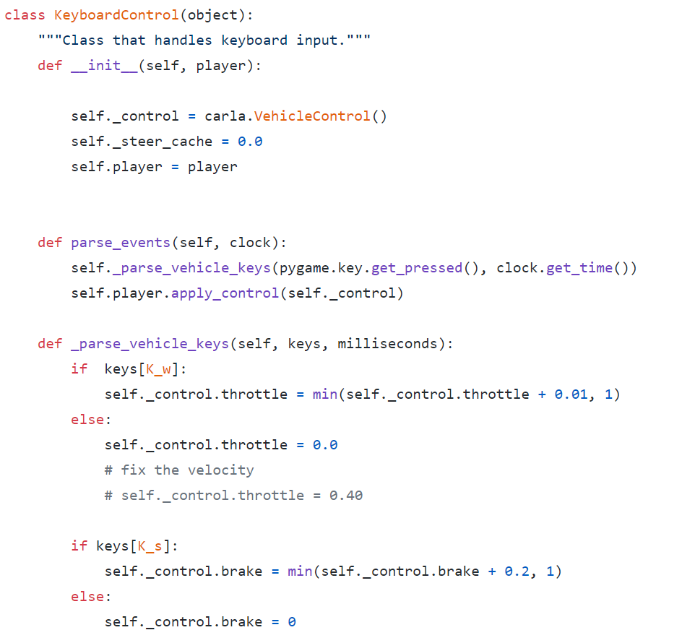
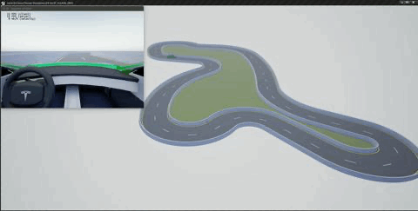
4. Control a Vehicle by Keyboard
Carla.VehicleControl and Pygame
Pygame keyboard event;
Carla.VehicleControl class;
Carla.Vehicle method apply_control;
Camera sensor position;
Camera sensor position
Notes:
使用键盘控制车辆前行。

Slide 11
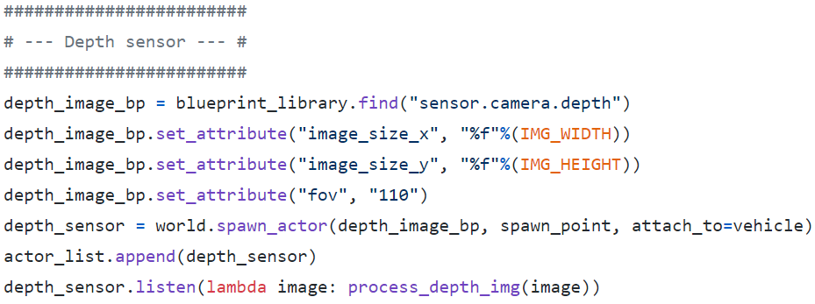
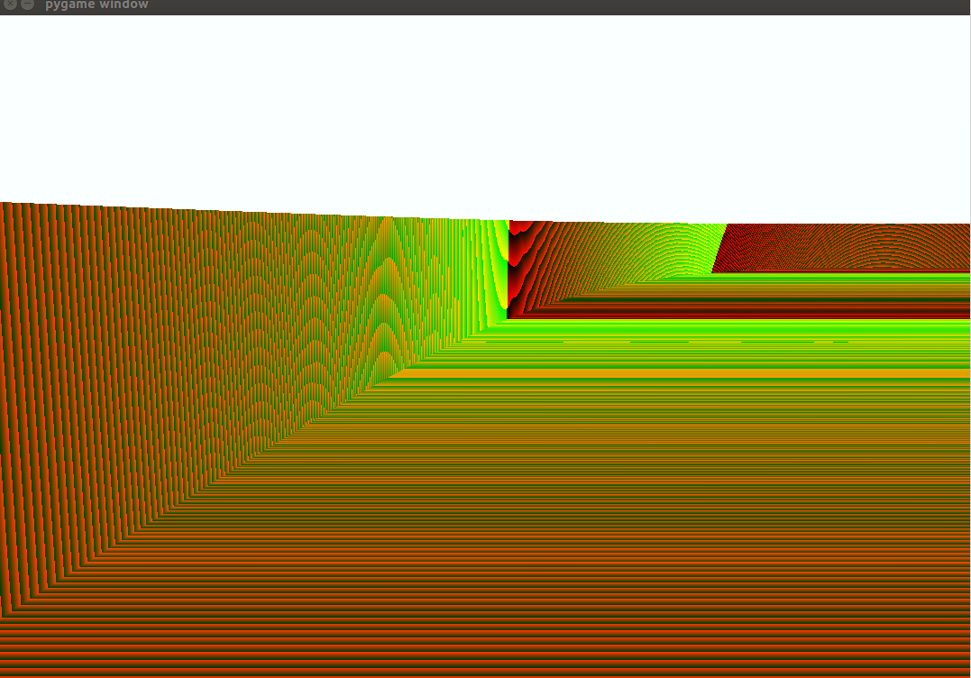
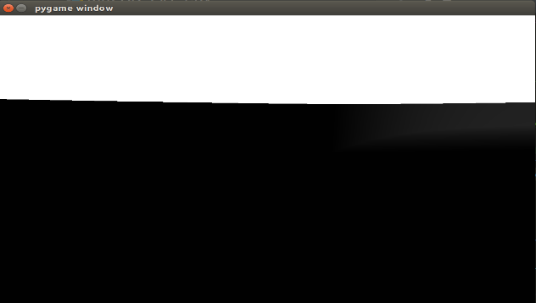
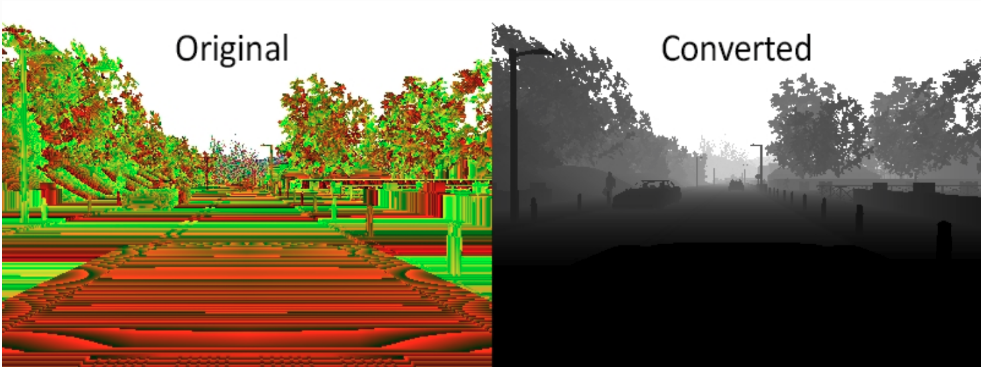
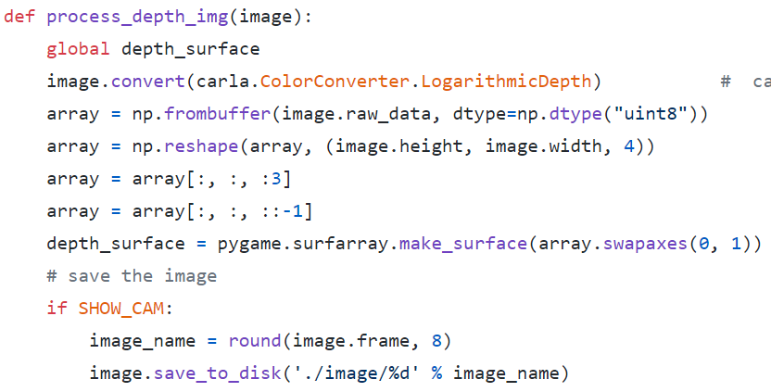
5. Different Sensors
Depth Sensor
Notes:
colorConverter 类，图像数据转换

Slide 12
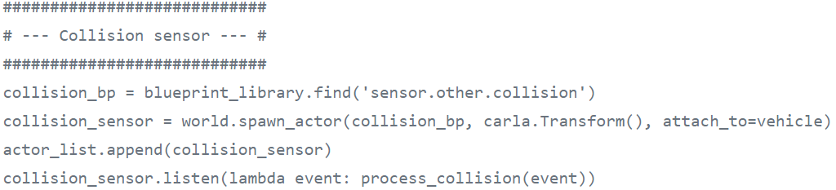
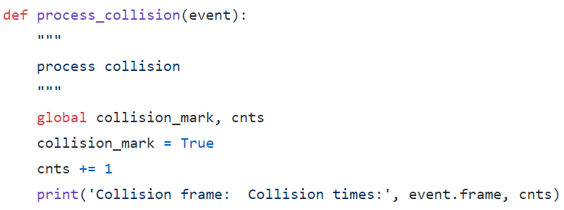
5. Different Sensors
Collision detector
Notes:
Collision没有属性设置
Continuous collision, sensor is invalid

Slide 13
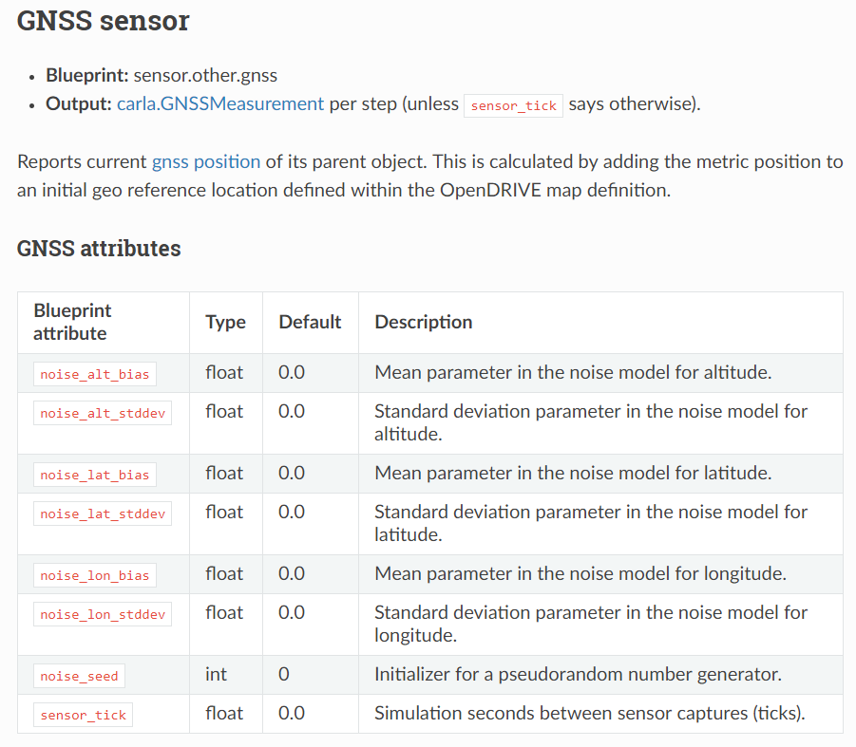
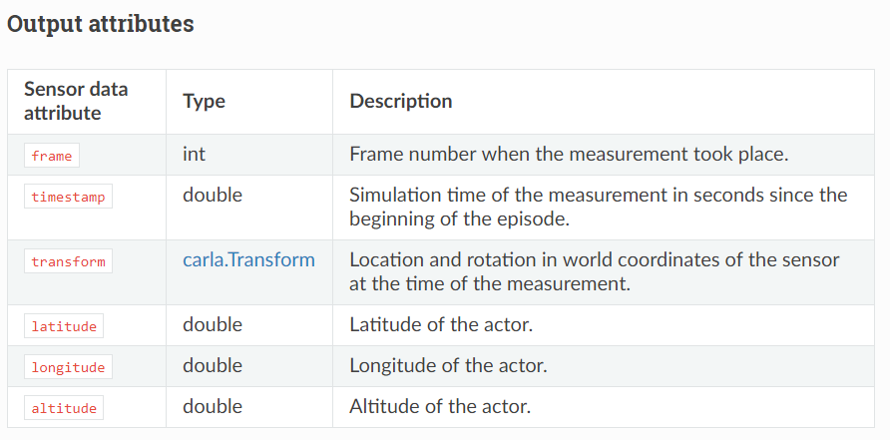
5. Different Sensors
GNSS sensor and IMU sensor
Notes:
GNSS: Global Navigation Satellite System
CARLA document
IMU也类似学习过程

Slide 14
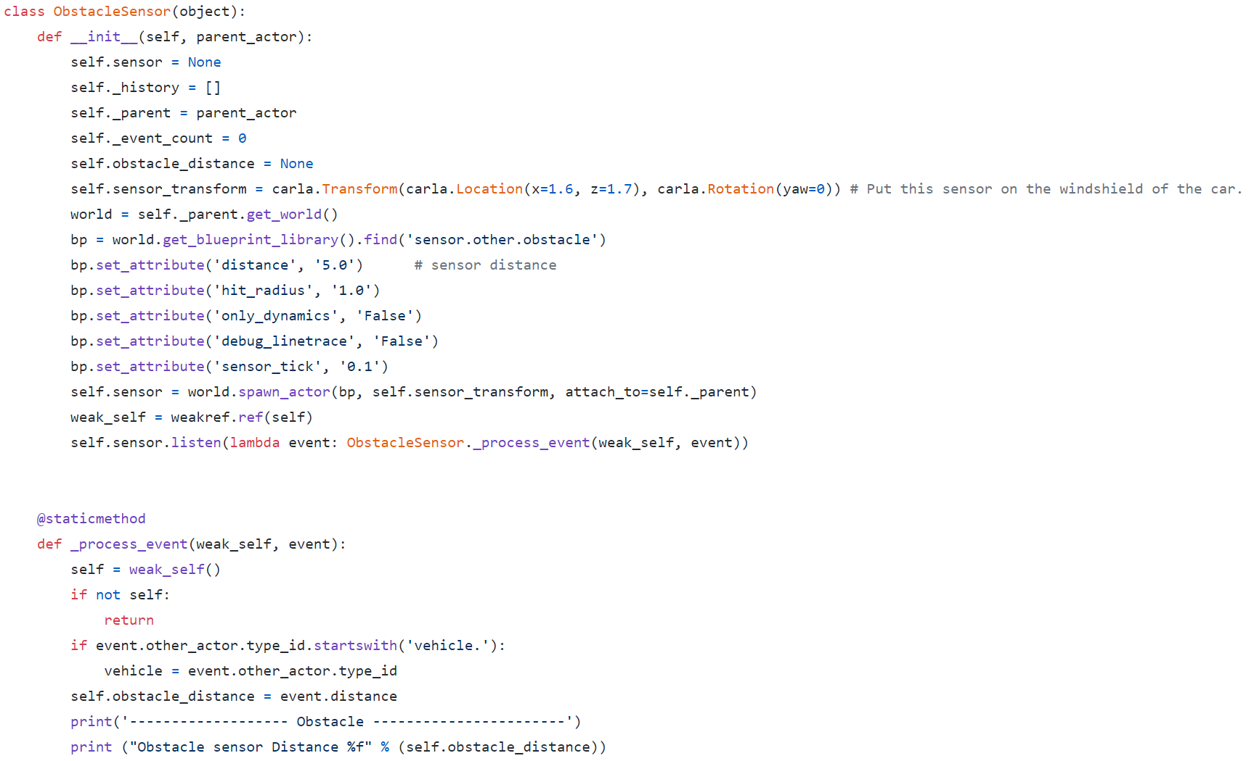
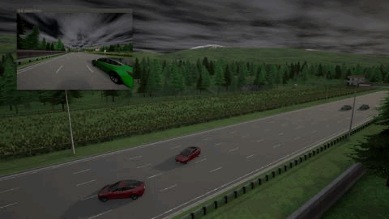
5. Different Sensors
Obstacle detector
Control distance
Notes:
Git issue：# Issues with obstacle detector #1286

Slide 15
MoCAD: Carla-python Experimental Course
Carla Sensors and Control a Vehicle by Keyboard
Game over !

